Slide 1
Graph
Lecture 17-18

Slide 2
Graph
Graphs and graph theory can be used to model:
– Computer networks
– Social networks
– Communications networks
– Information networks
– Software design
– Transportation networks
– Biological networks

Slide 3
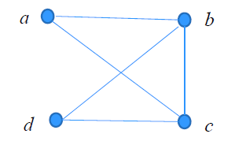
Graph
Definition: A graph G = (V, E) consists of a nonempty set V of vertices (or nodes) and a set E of edges. Each edge has either one or two vertices associated with it, called its endpoints. An edge is said to connect its endpoints.
Example

Slide 4
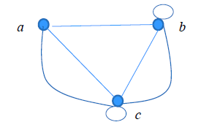
Terminology
In a simple graph each edge connects two different vertices and no two edges connect the same pair of vertices.
Multigraphs may have multiple edges connecting the same two vertices. When m different edges connect the vertices u and v, we say that {u,v} is an edge of multiplicity m.
• An edge that connects a vertex to itself is called a loop.
• A pseudograph may include loops, as well as multiple edges connecting the same pair of vertices.

Slide 5
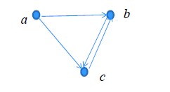
Directed graph
Definition: A directed graph (or digraph) G = (V, E) consists of a
nonempty set V of vertices (or nodes) and a set E of directed edges
(or arcs). Each edge is associated with an ordered pair of vertices.
The directed edge associated with the ordered pair (u,v) is said to
start at u and end at v.
Remark:
– Graphs where the end points of an edge are not ordered are said
to be undirected graphs.

Slide 6
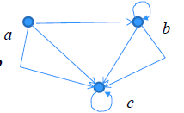
Directed graph
A simple directed graph has no loops and no multiple edges.
Example:
• A directed multigraph may have multiple directed edges.
When there are m directed edges from the vertex u to the
vertex v, we say that (u,v) is an edge of multiplicity m.
Example:
• multiplicity of (a,b) is ?
• and the multiplicity of (b,c) is ?

Slide 7
Directed graph
A simple directed graph has no loops and no multiple edges.
Example:
• A directed multigraph may have multiple directed edges.
When there are m directed edges from the vertex u to the
vertex v, we say that (u,v) is an edge of multiplicity m.
Example:
• multiplicity of (a,b) is ? 1
• and the multiplicity of (b,c) is ? 2

Slide 8
Undirected graph
Definition 1. Two vertices u, v in an undirected graph G are
called adjacent (or neighbors) in G if there is an edge e between u and v. Such an edge e is called an incident with the vertices u and v
and e is said to connect u and v.
Definition 2. The set of all neighbors of a vertex v of G = (V, E),
denoted by N(v), is called the neighborhood of v. If A is a subset
of V, we denote by N(A) the set of all vertices in G that are adjacent
to at least one vertex in A. So,
Definition 3. The degree of a vertex in an undirected graph is the
number of edges incident with it, except that a loop at a vertex
contributes two to the degree of that vertex. The degree of the
vertex v is denoted by deg(v).

Slide 9
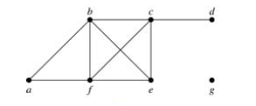
Undirected graph
Example: What are the degrees and neighborhoods of the vertices in the graphs G?
Solution:
G: deg(a) = 2,
deg(b) = deg(c) = deg(f ) = 4,
deg(d ) = 1,
deg(e) = 3,
deg(g) = 0.
N(a) = {b, f }, N(b) = {a, c, e, f }, N(c) = {b, d, e, f },
N(d) = {c}, N(e) = {b, c , f }, N(f) = {a, b, c, e}, N(g) = Ø .

Slide 10
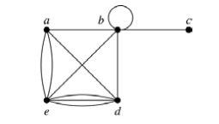
Undirected graph
Example: What are the degrees and neighborhoods of the vertices in the graphs H?
Solution:
H: deg(a) = 4, deg(b) = deg(e) = 6, deg(c) = 1, deg(d) = 5.
N(a) = {b, d, e}, N(b) = {a, b, c, d, e}, N(c) = {b},
N(d) = {a, b, e}, N(e) = {a, b ,d}.

Slide 11
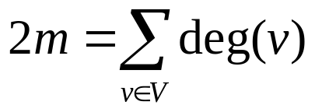
Undirected graph
Theorem 1 : If G = (V,E) is an undirected graph with m edges, then
Proof:
Each edge contributes twice to the degree count of all vertices.
Hence, both the left-hand and right-hand sides of this equation
equal twice the number of edges.

Slide 12
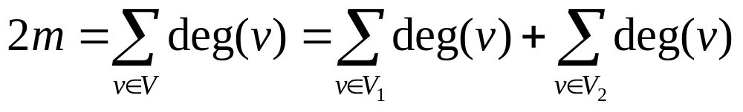
Undirected graph
Theorem 2: An undirected graph has an even number of vertices of odd degree.
Proof: Let V₁ be the vertices of even degree and V₂ be the vertices
of odd degree in an undirected graph G = (V, E) with m edges.
Then
must be
even since
deg(v) is
even for
each v ∈ V₁
This sum must be even because 2m
is even and the sum of the degrees
of the vertices of even degrees is
also even. Because this is the sum
of the degrees of all vertices of odd
degree in the graph, there must be
an even number of such vertices.

Slide 13
Directed graph
Definition: An directed graph G = (V, E) consists of V, a
nonempty set of vertices (or nodes), and E, a set of directed edges
or arcs. Each edge is an ordered pair of vertices. The directed
edge (u,v) is said to start at u and end at v.
Definition: Let (u,v) be an edge in G. Then u is the initial vertex
of this edge and is adjacent to v and v is the terminal (or end)
vertex of this edge and is adjacent from u. The initial and terminal
vertices of a loop are the same.

Slide 14
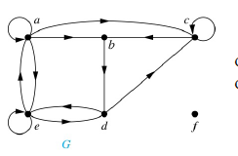
Directed graph
Definition: The in-degree of a vertex v, denoted deg⁻ (v), is
the number of edges which terminate at v. The out-degree of v,
denoted deg⁺(v), is the number of edges with v as their initial
vertex. Note that a loop at a vertex contributes 1 to both the indegree
and the out-degree of the vertex
Example: Assume graph G
deg⁻ (a)=2, deg⁻ (b)=2, deg⁻ (c)=3,
deg⁻ (d)=?, deg⁻ (e)=?, deg⁻ (f)=?

Slide 15
Directed graph
Definition: The in-degree of a vertex v, denoted deg⁻ (v), is
the number of edges which terminate at v. The out-degree of v,
denoted deg⁺(v), is the number of edges with v as their initial
vertex. Note that a loop at a vertex contributes 1 to both the indegree
and the out-degree of the vertex
Example: Assume graph G
deg⁻ (a)=2, deg⁻ (b)=2, deg⁻ (c)=2,
deg⁻ (d)=2, deg⁻ (e)=3, deg⁻ (f)=0

Slide 16
Directed graph
Definition: The in-degree of a vertex v, denoted deg⁻ (v), is
the number of edges which terminate at v. The out-degree of v,
denoted deg⁺(v), is the number of edges with v as their initial
vertex. Note that a loop at a vertex contributes 1 to both the indegree
and the out-degree of the vertex
Example: Assume graph G
Deg⁺ (a)=4, deg⁺ (b)=1, deg⁺ (c)=2,
deg⁺ (d)=?, deg⁺ (e)=?, deg⁺ (f)=?

Slide 17
Directed graph
Definition: The in-degree of a vertex v, denoted deg⁻ (v), is
the number of edges which terminate at v. The out-degree of v,
denoted deg⁺(v), is the number of edges with v as their initial
vertex. Note that a loop at a vertex contributes 1 to both the indegree
and the out-degree of the vertex
Example: Assume graph G
Deg⁺ (a)=4, deg⁺ (b)=1, deg⁺ (c)=2,
deg⁺ (d)=2, deg⁺ (e)=3, deg⁺ (f)=0

Slide 18
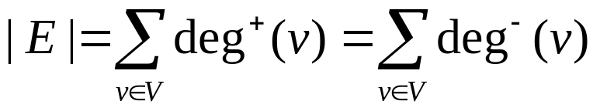
Directed graph
Theorem: Let G = (V, E) be a graph with directed edges. Then:
Proof:
The first sum counts the number of outgoing edges over all vertices
and the second sum counts the number of incoming edges over all
vertices. It follows that both sums equal the number of edges in the
graph.

Slide 19
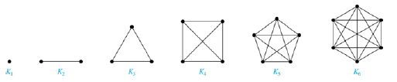
Complete graph
A complete graph on n vertices, denoted by K_{n}, is the simple
graph that contains exactly one edge between each pair of distinct
vertices.

Slide 20
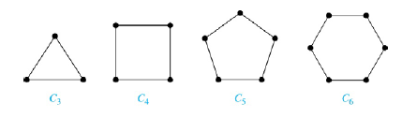
A Cycle
A cycle C_{n} for n ≥ 3 consists of n vertices v₁, v₂ ,⋯ , v_{n}, and edges
{v₁, v₂}, {v₂, v₃} ,⋯ , {v_{n-1}, v_{n}}, {v_{n}, v₁}.

Slide 21
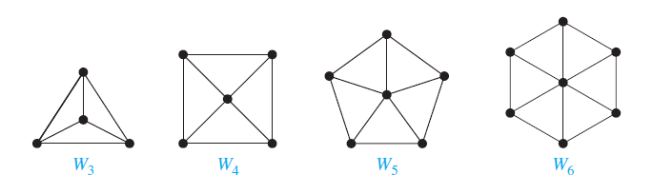
A Wheel
We obtain a wheel Wn when we add an additional vertex to a cycle Cn, for n ≥ 3, and connect this new vertex to each of the n vertices in Cn, by new edges.

Slide 22
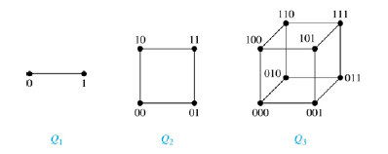
N-dimensional hypercube
An n-dimensional hypercube, or n-cube, Q_{n}, is a graph with 2^{n}
vertices representing all bit strings of length n, where there is an
edge between two vertices that differ in exactly one bit position.

Slide 23
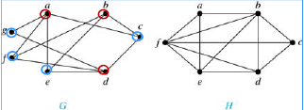
Bipartite Graph
Definition: A simple graph G is bipartite if V can be partitioned
into two disjoint subsets V₁ and V₂ such that every edge connects a
vertex in V₁ and a vertex in V₂. In other words, there are no edges
which connect two vertices in V₁ or in V₂.
Example: Job Assignment Problem, Marriages on an Island

Slide 24

Bipartite Graph
Example: Show that C₆ is bipartite.

Slide 25
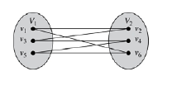
Bipartite Graph
Example: Show that C₆ is bipartite.
Solution: We can partition the vertex set into V₁ = {v₁, v₃, v₅} and V₂ = {v₂, v₄, v₆} so that every edge of C₆ connects a vertex in V₁ and V₂ .

Slide 26

Bipartite Graph
Example: Show that C₃ is not bipartite.

Slide 27
Bipartite Graph
Example: Show that C₃ is not bipartite.
Solution: If we divide the vertex set of C₃ into two nonempty sets, one of the two must contain two vertices. But in C₃ every vertex is connected to every other vertex. Therefore, the two vertices in the same partition are connected. Hence, C₃ is not bipartite.

Slide 28
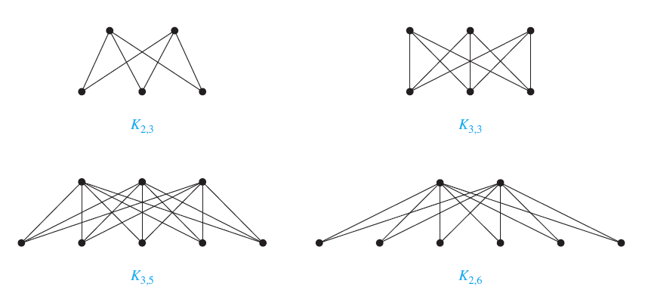
Complete Bipartite Graph
Definition: A complete bipartite graph Km,n is a graph that has its vertex set partitioned into two subsets V₁ of size m and V₂ of size n such that there is an edge from every vertex in V₁ to every vertex in V₂.
Example: We display four complete bipartite graphs here.

Slide 29
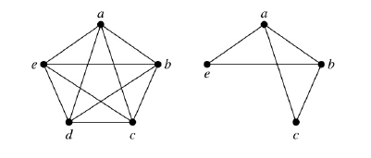
Subgraph
Definition: A subgraph of a graph G = (V,E) is a graph (W,F), where W ⊂ V and F ⊂ E. A subgraph H of G is a proper subgraph of G if H ≠ G.
Example: K₅ and one of its subgraphs.

Slide 30
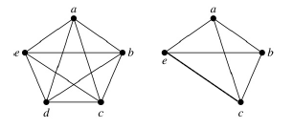
Subgraph
Definition: Let G = (V, E) be a simple graph. The subgraph induced by a subset W of the vertex set V is the graph (W,F), where the edge set F contains an edge in E if and only if both endpoints are in W.
Example: K₅ and the subgraph induced by W = {a,b,c,e}.

Slide 31
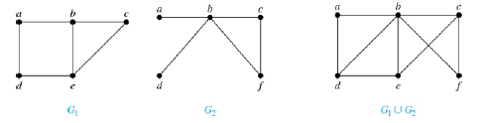
Union of Graph
Definition: The union of two simple graphs G₁ = (V₁, E₁) and G₂ = (V₂, E₂) is the simple graph with vertex set V₁ ⋃ V₂ and edge set E₁ ⋃ E₂. The union of G₁ and G₂ is denoted by G₁ ⋃ G₂.
Example:

Slide 32
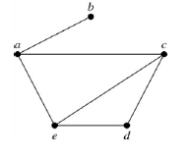
Representation: Adjacency List
Definition: An adjacency list can be used to represent a graph with no multiple edges by specifying the vertices that are adjacent to each vertex of the graph.
Example:
An adjacency list for a simple graph
vertex | Adjacent vertex
a | b, c, e
b | a
c | a, d, e
d | c, e
e | a, c, d

Slide 33
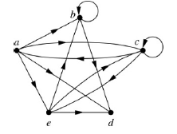
Representation: Adjacency List
Definition: An adjacency list can be used to represent a graph with no multiple edges by specifying the vertices that are adjacent to each vertex of the graph.
Example:
An adjacency list for a directed graph
vertex | Adjacent vertex
a | b, c, d, e
b | b, d
c | a, c, e
d
e | b, c, d

Slide 34
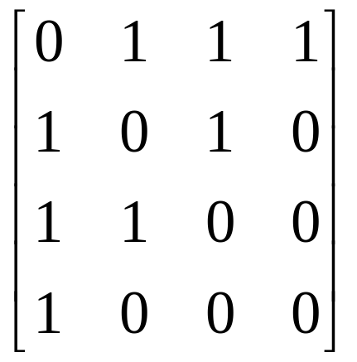

Adjacency Matrix
Definition: Suppose that G = (V, E) is a simple graph where |V| = n. Arbitrarily list the vertices of G as v₁, v₂, … , v_{n}. The adjacency matrix A_{G} of G, with respect to the listing of vertices, is the n × n zero-one matrix with 1 as its (i, j)th entry when v_{i} and v_{j} are adjacent, and 0 as its (i, j)th entry when they are not adjacent.
Example:

Slide 35
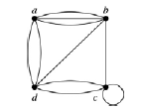
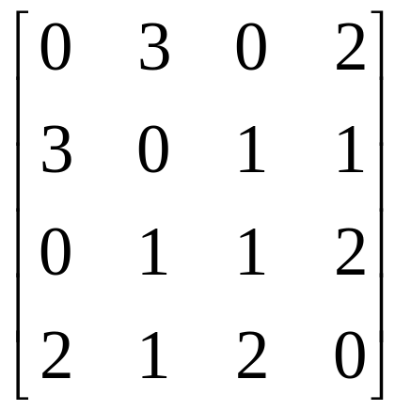
Adjacency Matrix
Adjacency matrices can also be used to represent graphs with loops and multiple edges.
• A loop at the vertex vi is represented by a 1 at the (i, i)th position of the matrix.
• When multiple edges connect the same pair of vertices vi and vj, (or if multiple loops are present at the same vertex), the (i, j)th entry equals the number of edges connecting the pair of vertices.
Example: The adjacency matrix of the pseudograph shown here using the ordering of vertices a, b, c, d.

Slide 36
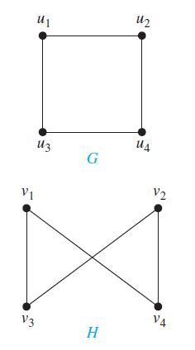
Graph Isomorphism
Definition: The simple graphs G₁ = (V₁, E₁) and G₂ = (V₂, E₂) are
isomorphic if there is a one-to-one and onto function f from V₁ to
V₂ with the property that a and b are adjacent in G₁ if and only if
f(a) and f(b) are adjacent in G₂, for all a and b in V₁. Such a
function f is called an isomorphism. Two simple graphs that are not
isomorphic are called nonisomorphic.
one-to-one correspondence between vertices of the two graphs that preserves the adjacency relationship
Are the two graph isomorphic?

Slide 37
Graph Isomorphism
Definition: The simple graphs G₁ = (V₁, E₁) and G₂ = (V₂, E₂) are
isomorphic if there is a one-to-one and onto function f from V₁ to
V₂ with the property that a and b are adjacent in G₁ if and only if
f(a) and f(b) are adjacent in G₂ , for all a and b in V₁ . Such a
function f is called an isomorphism. Two simple graphs that are not
isomorphic are called nonisomorphic.
Are the two graph isomorphic?
u₁ → v₁
u₂ → v₄
u₃ → v₃
u₄ → v₂
f(u₁) = v₁ and f (u₂) = v₄, f (u₁) = v₁ and f (u₃) = v₃, f (u₂) = v₄ and f (u₄) = v₂,
and f (u₃) = v₃ and f (u₄) = v₂

Slide 38
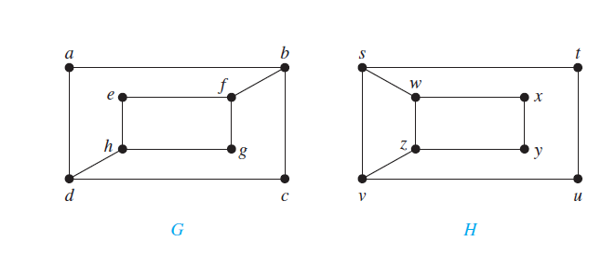
Graph Isomorphism
Example: Are Graph G and Graph H isomorphic?
The graphs G and H both have eight vertices and 10 edges. They also both have four vertices of degree two and four of degree three.
However, G and H are not isomorphic. To see this, note that because deg(a) = 2 in G, a must correspond to either t, u, x, or y in H. Because these are the vertices of degree two in H.
However, each of these four vertices in H is adjacent to another vertex of degree two in H, which is not true for a in G.

Slide 39
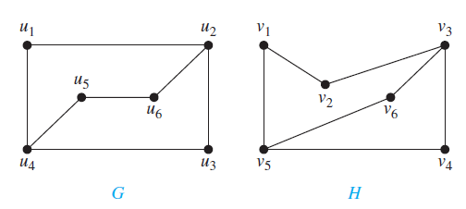
Graph Isomorphism
Example: Are Graph G and Graph H isomorphic?
deg(u1) = 2 and because u1 is not adjacent to any other vertex of degree two, the image of u1 must be either v4 or v6. We arbitrarily set f (u1) = v6.
u2 is adjacent to u1, the possible images of u2 are v3 and v5. We arbitrarily set f (u2) = v3.
Similarly, we can set f (u3) = v4, f (u4) = v5, f (u5) = v1, and f (u6) = v2
Therefore, Graph G and Graph H are isomorphic.

Slide 40
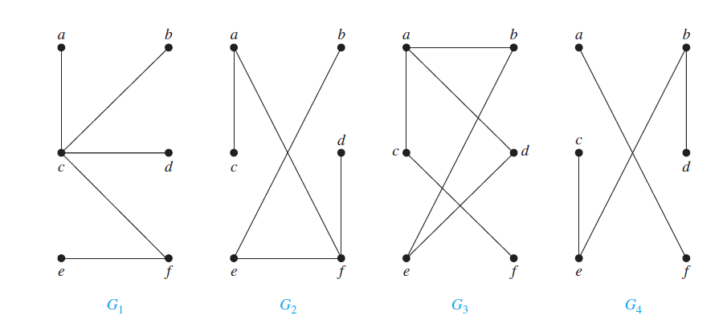
Tree
Definition: A tree is a connected undirected graph with no simple circuits.
Example:
Tree: Yes
Tree: Yes
Tree: No
Tree: No

Slide 41
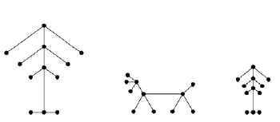
Tree
Definition: A forest is a graph that has no simple circuit, but is not
connected. Each of the connected components in a forest is a tree.
Example:

Slide 42
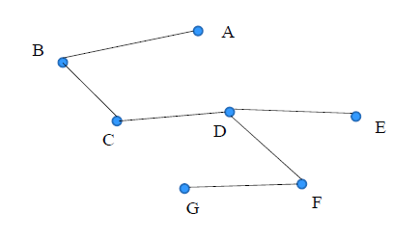
Tree
Theorem: An undirected graph is a tree if and only if there is a
unique simple path between any two of its vertices.
Example:

Slide 43
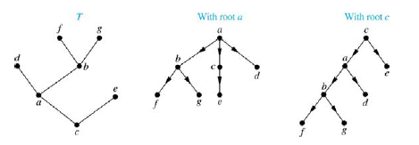
Rooted Tree
Definition: A rooted tree is a tree in which one vertex has been
designated as the root and every edge is directed away from the
root.
Note: An unrooted tree can be converted into different rooted trees
when one of the vertices is chosen as the root.

Slide 44
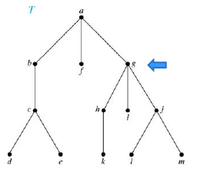
Rooted Tree Terminology
If v is a vertex of a rooted tree other than the root, the parent of v is
the unique vertex u such that there is a directed edge from u to v.
When u is a parent of v, v is called a child of u. Vertices with the
same parent are called siblings.
Parent of g: a
Children of g: h,i,j
Sibling: b, f

Slide 45
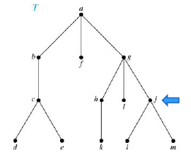
Rooted Tree Terminology
The ancestors of a vertex are the vertices on the path from the root
to this vertex, excluding the vertex itself and including the root.
The descendants of a vertex v are those vertices that have v as an
ancestor.
Ancestor j: g, a descendant j: l, m

Slide 46
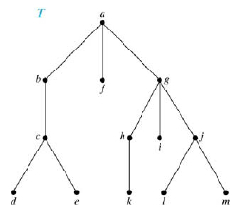
Rooted Tree Terminology
A vertex of a rooted tree with no children is called a leaf. Vertices
that have children are called internal vertices.
Leafs: d, e, k, l, m
Examples of internal nodes: b, g, h

Slide 47
Rooted Tree Terminology
If a is a vertex in a tree, the subtree with a as its root is the
subgraph of the tree consisting of a and its descendants and all
edges incident to these descendants.

Slide 48
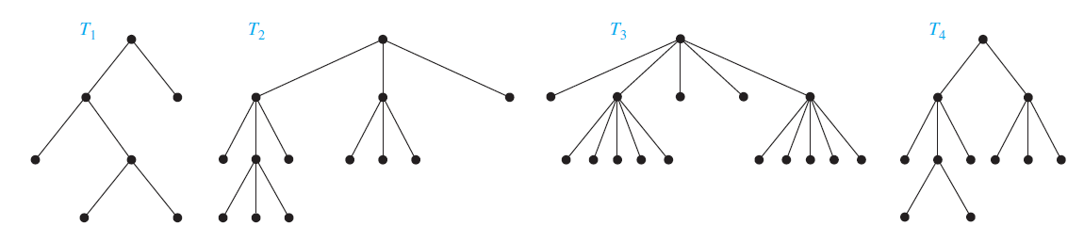
M-ary Tree
Definition: A rooted tree is called an m-ary tree if every internal
vertex has no more than m children. The tree is called a full m-ary
tree if every internal vertex has exactly m children. An m-ary tree
with m = 2 is called a binary tree.
Full 2-Ary Tree
Full 3-Ary Tree
Full 5-Ary Tree
No m-Ary Tree

Slide 49
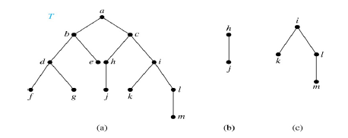
Binary Tree
A binary tree is an ordered rooted where each internal
vertex has at most two children. If an internal vertex of a binary
tree has two children, the first is called the left child and the second
the right child. The tree rooted at the left child of a vertex is called
the left subtree of this vertex, and the tree rooted at the right child
of a vertex is called the right subtree of this vertex.

Slide 50
Thank You

